Slide 1

Project Name
COLLEGE WEBSITE
Presented by | Himanshu Yuvraj Bari (196580316002) Patel Jash Santoshkumar (196580316028)
Guide Name | Shri Rajesh Kumar Pendem
Group no. | 10
Department | Information Technology
College | Government Polytechnic Daman
Year | 2022

Slide 2
CONTENTS
SR NO. | TITLE | SLIDE NO.
01 | GANTT CHART | 4
02 | PROBLEM STATEMENT | 5
03 | EXISTING SYSTEM | 6
04 | PROPOSED SYSTEM | 7
05 | SOFTWARE DEVELOPMENT LIFECYCLE | 8
07 | FEASIBILITY STUDY | 9

Slide 3
CONTENTS
SR NO. | TITLE | SLIDE NO.
07 | SRS | 12
08 | Design - ER, DFD | 18
09 | Result | 23
10 | Limitation of System | 32
11 | Future Scope | 33
12 | References | 35

Slide 4
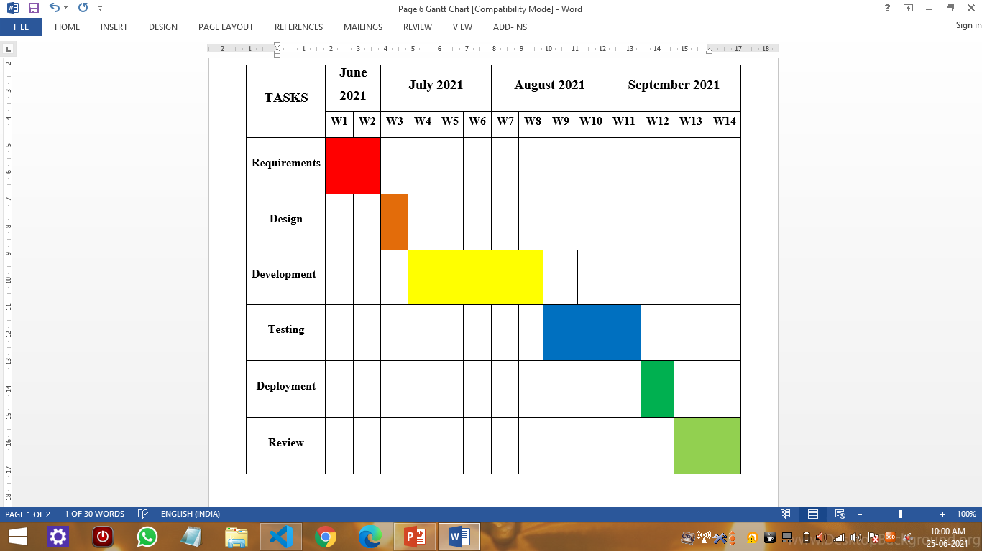
GANTT CHART

Slide 5
2. PROBLEM STATEMENT
No Platform for College to Showcase the Facility and Infrastructure Details.
No Online Platform for College contact and Regular Updates regarding Tenders, Circulars, Events etc.
No Online Platform to Present Images and Video Gallery of Events and Programs.
No Platform for Students to get Details about them and Verification of it and Academic Details also.
Teachers cannot Post Circulars and Updates at One Platform

Slide 6
3. EXISTING SYSTEM
Students have to visit College for Getting Admission.
College has to Facility to show Circulars and Notice at Online Platform.
Visitors have to visit College Premises.
Waste of Energy, Time and Money.
Cannot Get Information by Computer or Smartphone.
Students have to visit College for Getting Details about College and Faculties.

Slide 7
4. PROPOSED SYSTEM
Our Project “College Website” provides a website for our College.
He/She can also get Information regarding College like Faculty, Staff, Infrastructure, Courses college Offers.
There will be a centralized platform for all needs of communication.
Less Paperwork required so beneficial for environment.
No waste of time, manpower and energy.
So that Anyone can visit to the website of College and gets details about it.
All facilities will be at students fingertips.

Slide 8
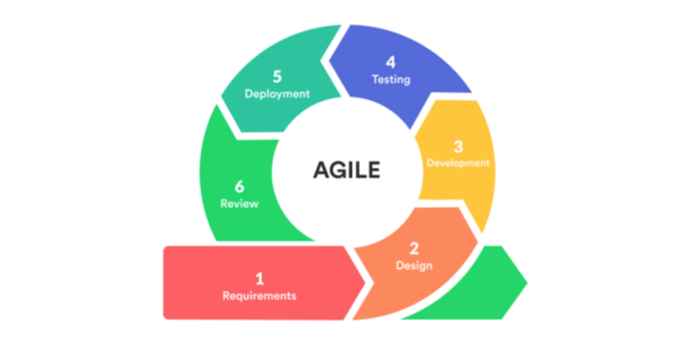
5. SOFTWARE DEVELOPMENT LIFECYCLE MODEL

Slide 9
6. FEASIBILITY STUDY
6.1 TECHNICAL FEASIBILITY
Project needs memory requirement 256GB ROM and 32 bit Processor.This is very feasible in this perspective.
This project can be loaded on any operating system with supports modern browser such as chrome, mozilla, edge, safari.
The Hardware and software used a normally available and satisfies a individual's general budgets.

Slide 10
6. FEASIBILITY STUDY
6.2 ECONOMIC FEASIBILITY
As we know that the system development costs are usually one time costs that will not recur after the project has been completed the calculating the development costs.
No. | Name | Cost
1 | VS Code, Notepad++, Xampp, Chrome Dev Tools | Free
2 | Computer with 4GB RAM - 250GB Storage and Intel i3 Processor | INR 42,000 approx.
3 | Wifi Internet Connection | INR 399 / month approx
4 | Hosting and Domain Name Purchase | INR 3000 approx (T&C apply)

Slide 11
7. SOFTWARE REQUIREMENT SPECIFICATION
7.1 FUNCTIONAL REQUIREMENT
The website will be able Provide information about College to Visitors
Faculty Details
Infrastructure Details
Library And Labs Details
Admission Process
Contact Details
Department Details
Notice Board

Slide 12
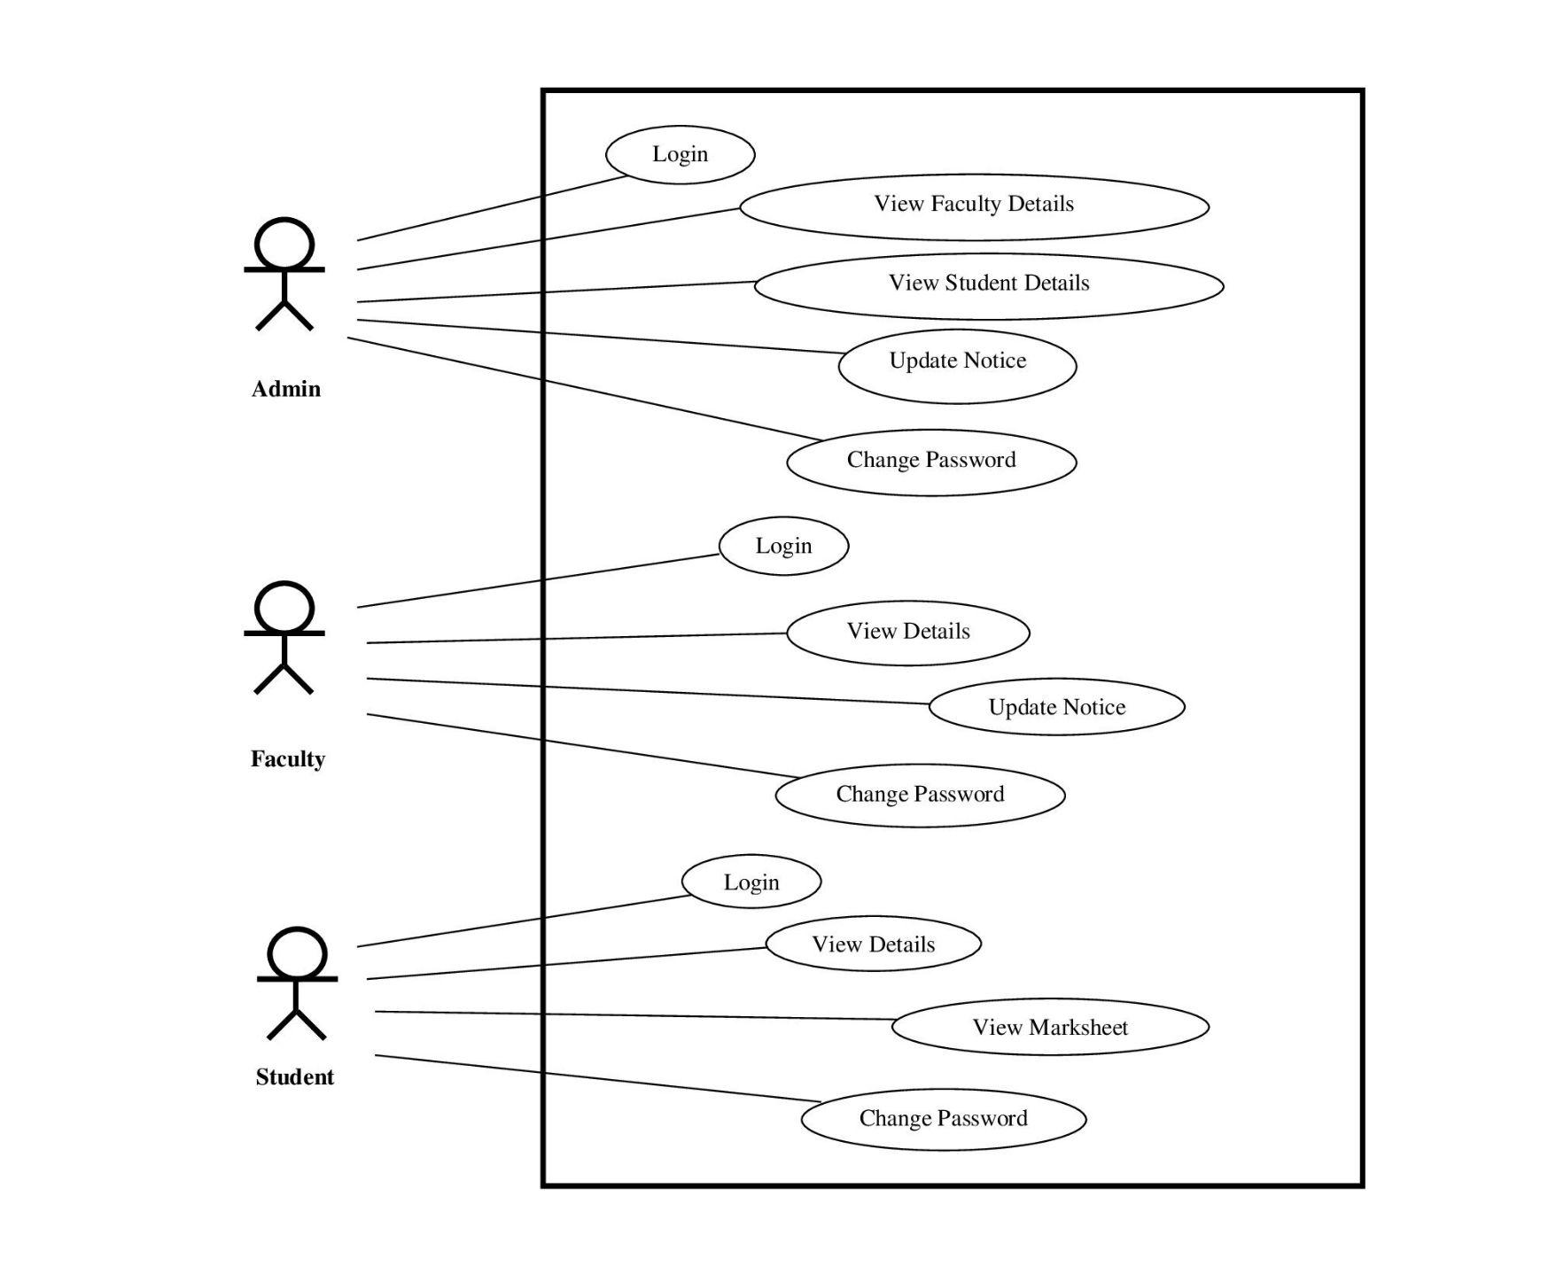



7. SOFTWARE REQUIREMENT SPECIFICATION
7.2 USE CASE DIAGRAM

Slide 13
7. SOFTWARE REQUIREMENT SPECIFICATION
7.3 NON FUNCTIONAL REQUIREMENT
Security - The Password are Encrypted with MD5 Algorithm.
Privacy - The methods used to collect and Store Data from Students are Safe and Secure
Performance - Simple, Fast and Clean UI/UX of our website ensures Good Performance.
Maintainability - Website can be maintained by Any Web Developer who has plenty knowledge of HTML, CSS, PHP, MySQL and JavaScript

Slide 14
7. SOFTWARE REQUIREMENT SPECIFICATION
7.4 GOALS OF IMPLEMENTATION
Students will be able to verify their Certificate Online
No Worries if document lost or theft ,they can be get again Online by some easy Processes.
College will have a Good Online Presence.
This will Increase No. of Admission and will be Profitable for College to get Best out of Best Student.

Slide 15
7. SOFTWARE REQUIREMENT SPECIFICATION
7.5 HARDWARE SPECIFICATION
Sr. No. | Description
1. | System with Minimum 250GB Storage
2. | System with Minimum 4 GB RAM
3. | Ryzen AMD A3 Processor
4. | SmartPhone, Desktop and other Display Sizes Devices

Slide 16
7. SOFTWARE REQUIREMENT SPECIFICATION
7.5 SOFTWARE SPECIFICATION
Sr. No. | Type | System
1. | Operating System | Windows (7, 10)
2. | Language | HTML5, CSS3, JavaScript 6, PHP
3. | Database | MySQL, Xampp(For Local Host Management)
4. | IDE | Microsoft VS code, Notepad++
5. | Browser | Chrome, Mozilla firefox, MS Edge, Safari

Slide 17
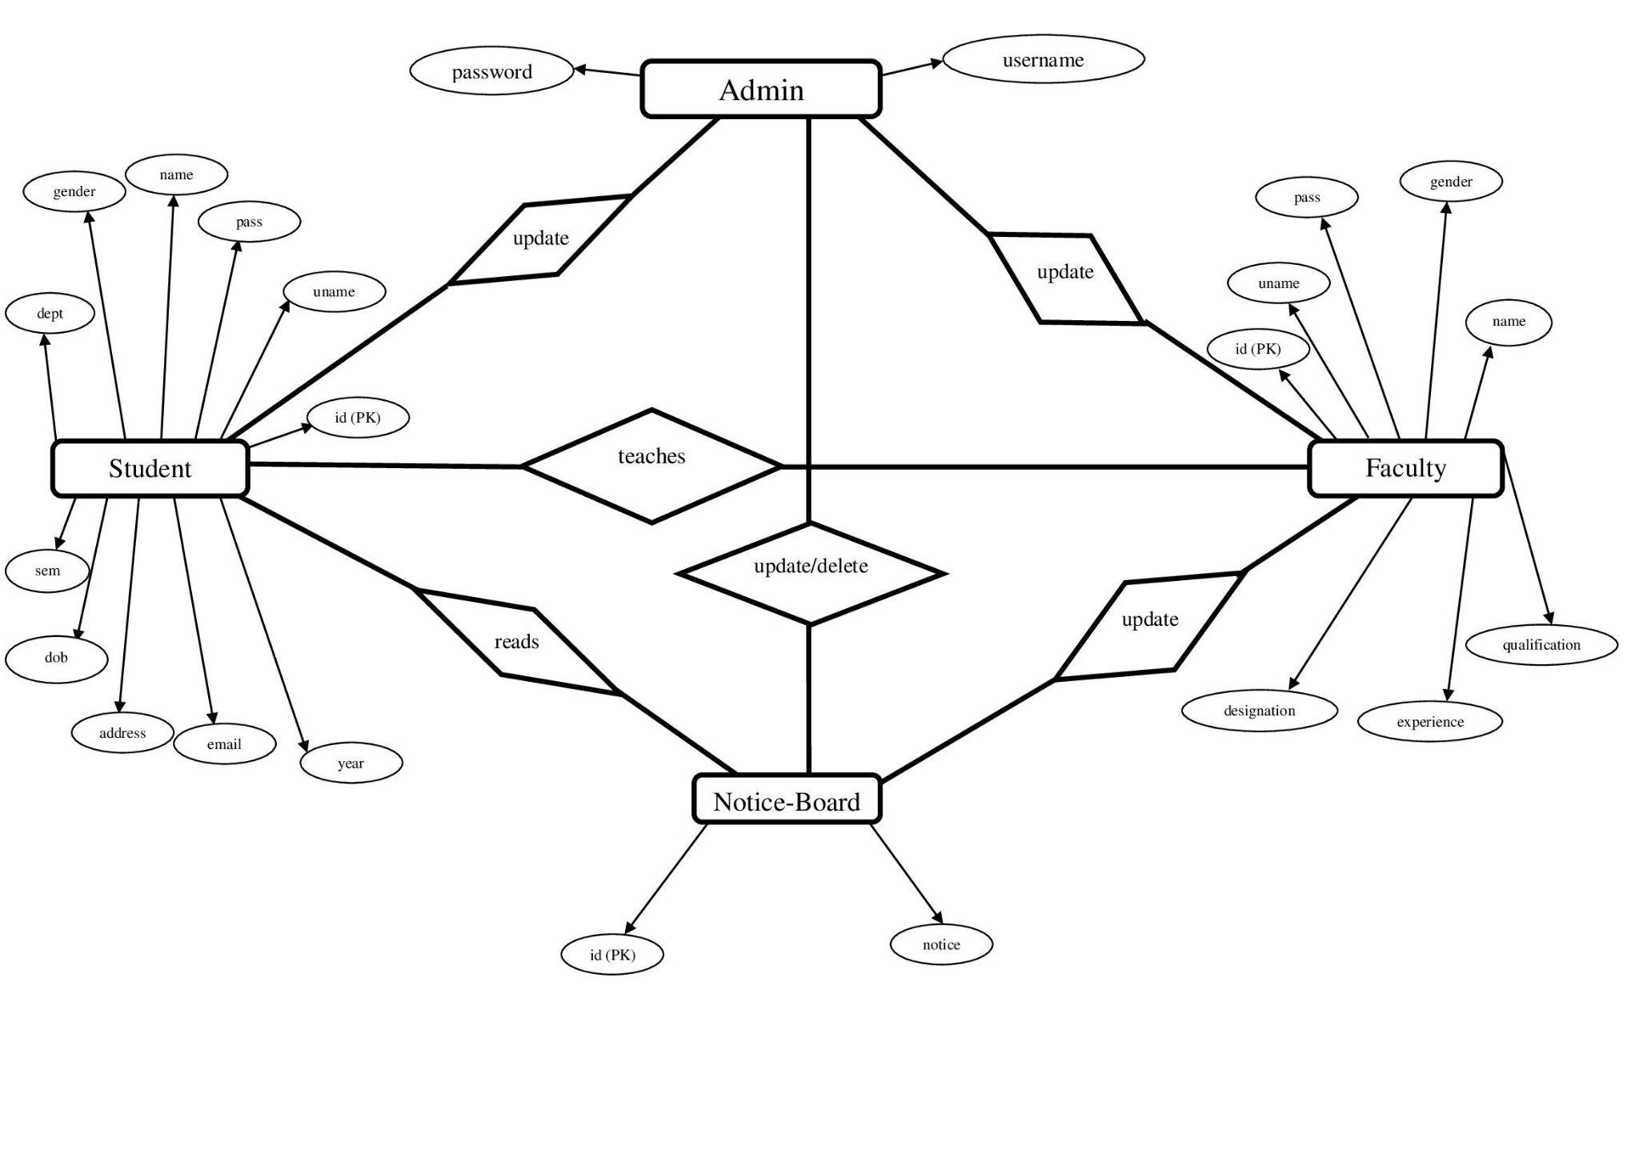
8. DESIGN
8.1 ER DIAGRAM

Slide 18
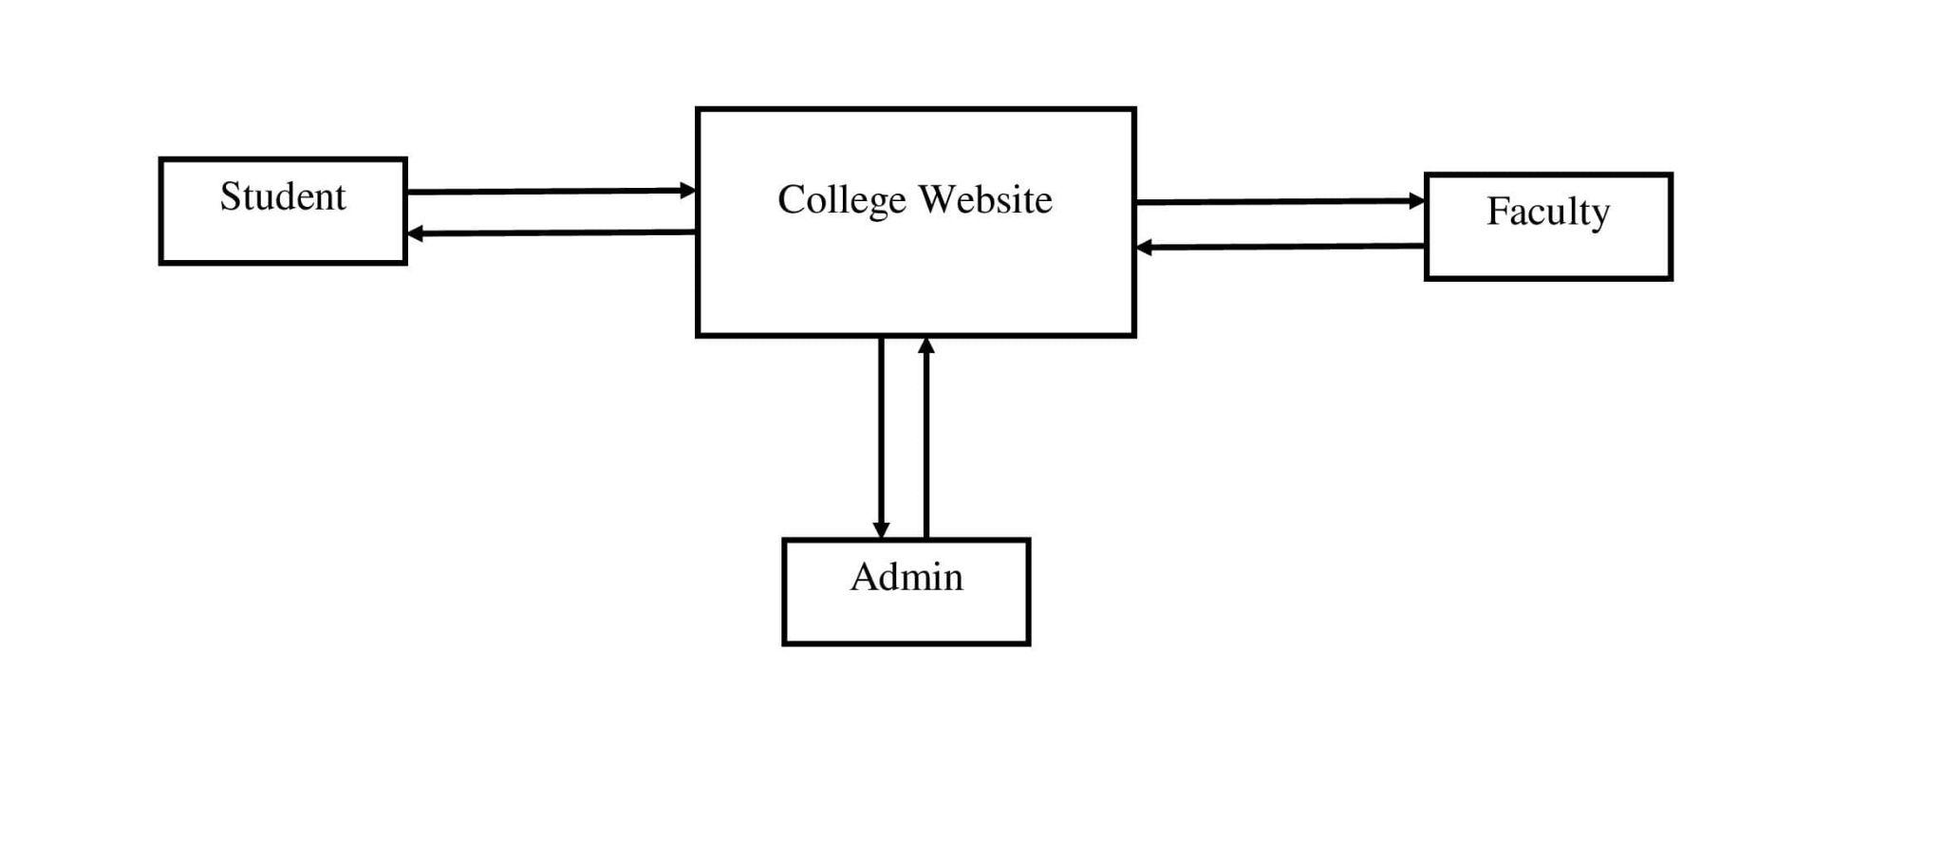
8. DESIGN
8.1 DATA FLOW DIAGRAM - BASIC LEVEL

Slide 19
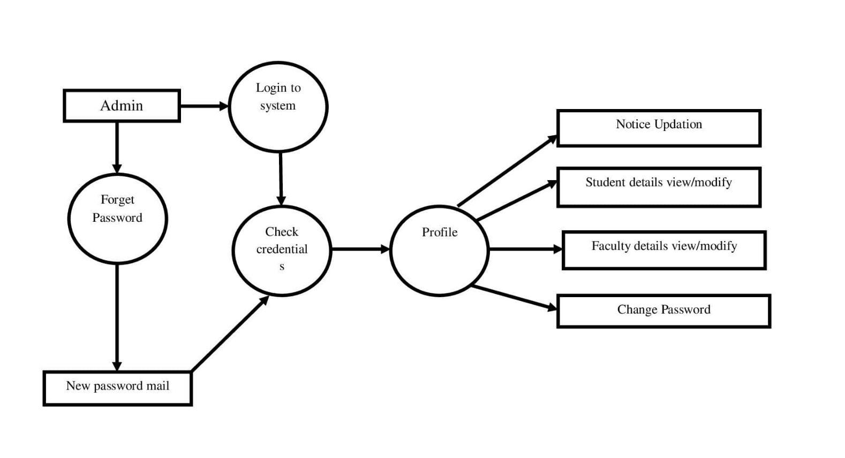
8. DESIGN
8.1 DATA FLOW DIAGRAM - ADMIN

Slide 20
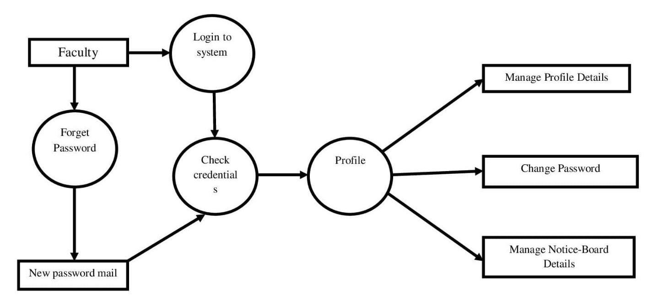
8. DESIGN
8.1 DATA FLOW DIAGRAM - FACULTY

Slide 21
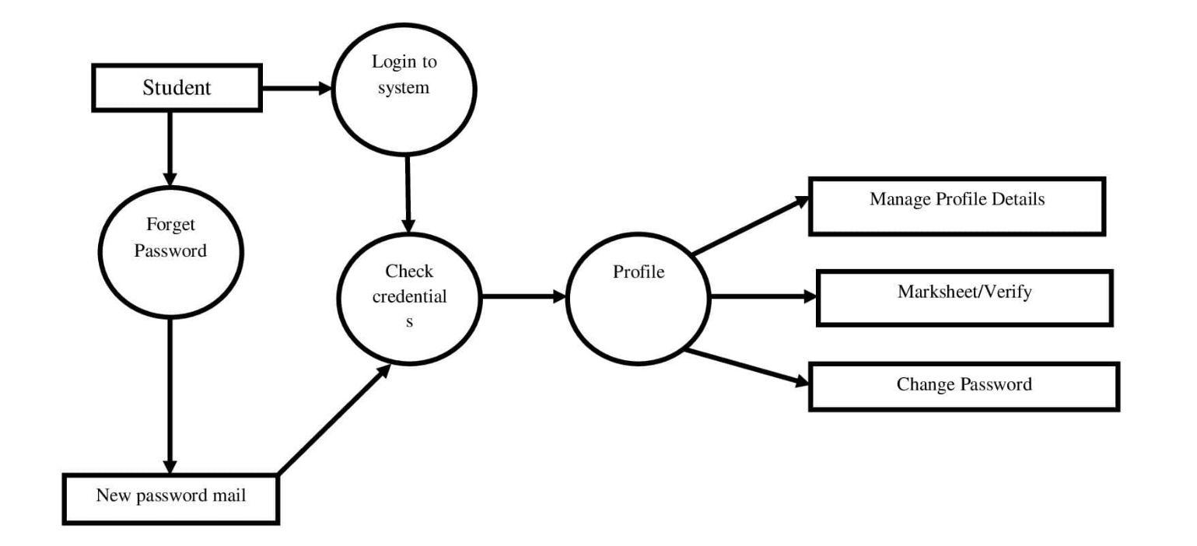
8. DESIGN
8.1 DATA FLOW DIAGRAM - STUDENT

Slide 22
9. RESULTS
The Result will be a Clean , Functional , Dynamic Website.
This are some Screenshots

Slide 23
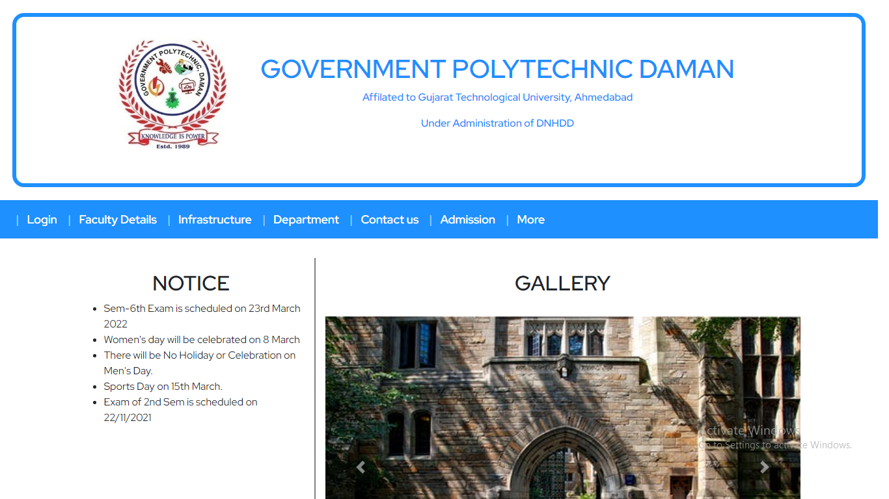
HOMEPAGE

Slide 24
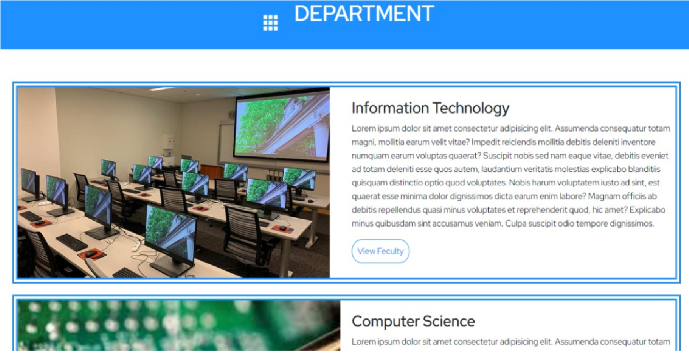
DEPARTMENT
DEPARTMENT

Slide 25
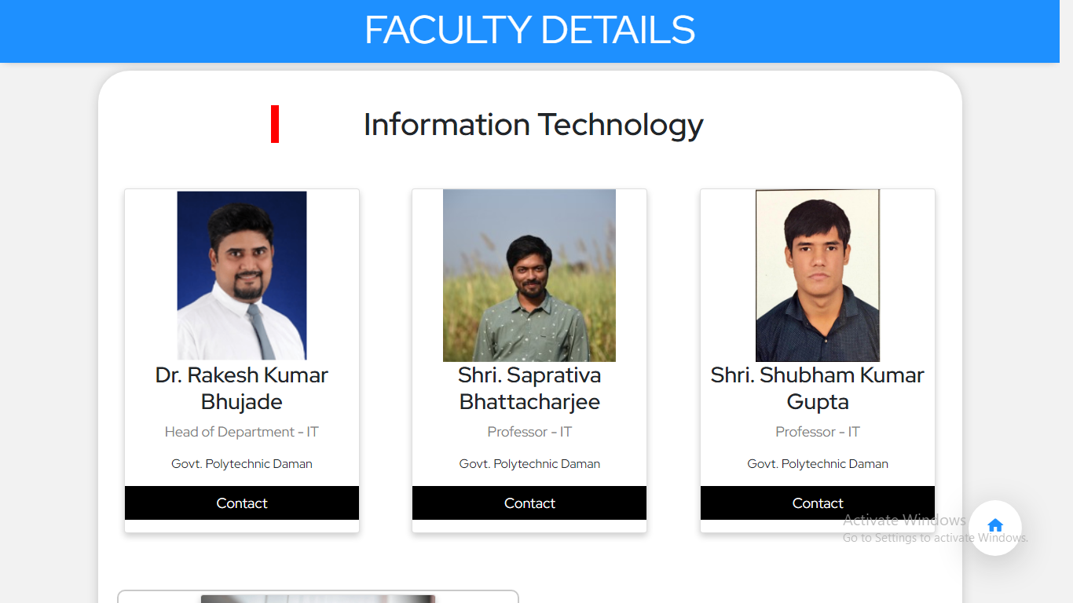
FACULTY DETAILS

Slide 26
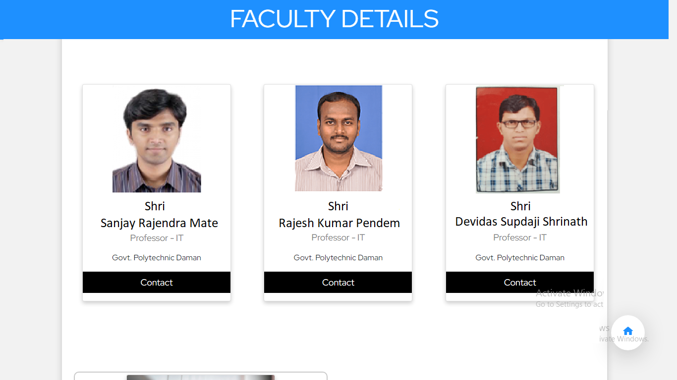
FACULTY DETAILS

Slide 27
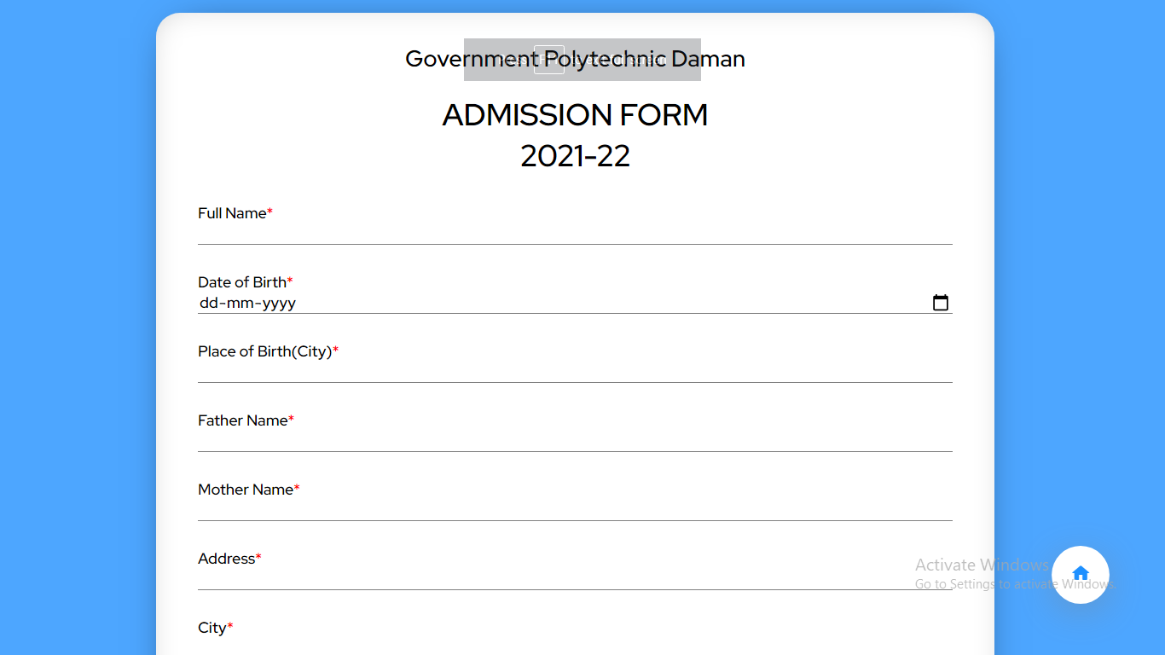
ADMISSION FORM

Slide 28
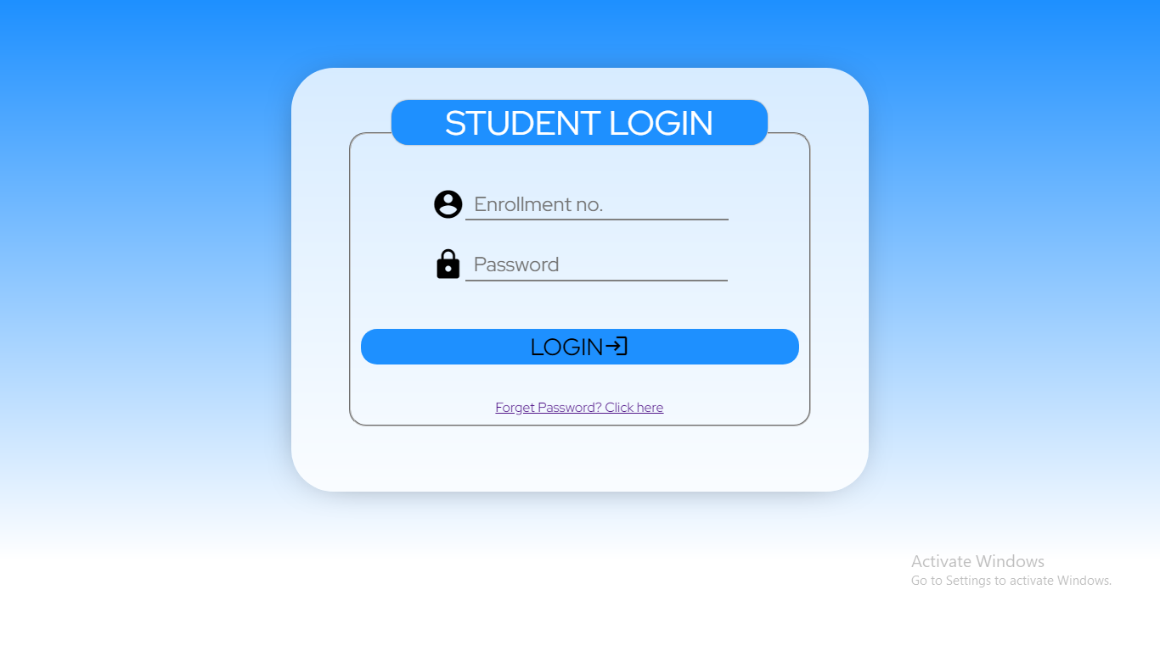
STUDENT LOGIN

Slide 29
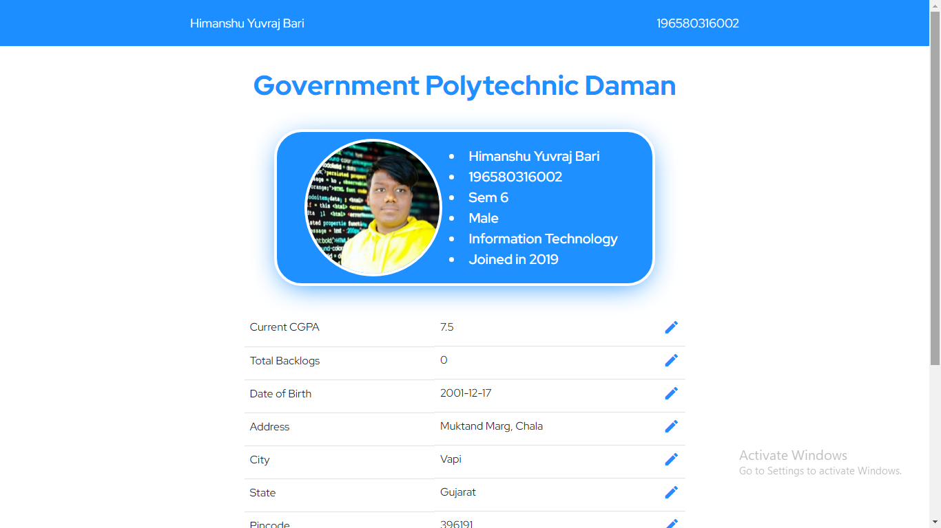
STUDENT PROFILE

Slide 30
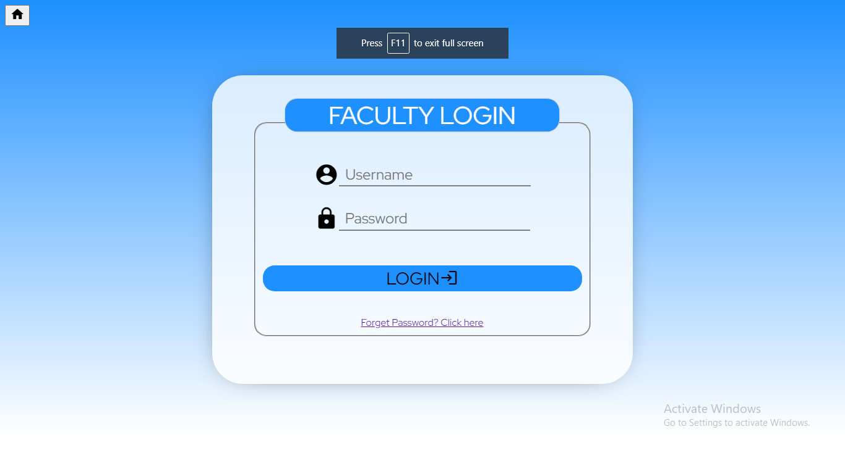
FACULTY LOGIN

Slide 31
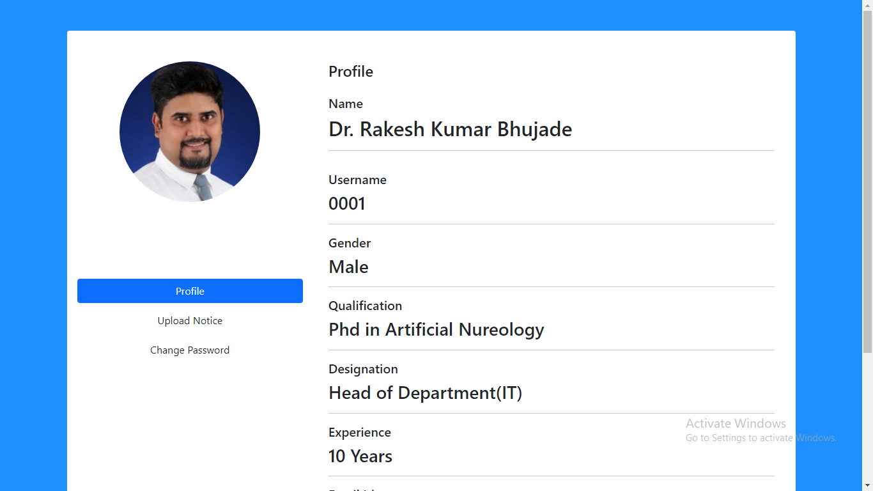
FACULTY PROFILE

Slide 32
10. LIMITATION
Our Website currently doesn’t provide direct communication between Entities like Faculty and Students.
The chat bot on website is static and doesn’t support AI or Machine Learning Answers.
Students still have to Pay their Fees and Other Monetary Transactions with Offline mode

Slide 33
11. FUTURE SCOPE
11.1 Providing Communication
Capabilities between Teachers and Student on the website to communicate with each other.
Providing Facilities to Teacher so they can receive and send Notification.
Students will be able to Pay their Fees and Other Monetary Transactions with Online mode.

Slide 34
11. FUTURE SCOPE
11.2 Enhancing AI Chatbot.
Making the chatbot more user friendly and Intelligent so that it can Answer most of Manual Question.
Adding more Details and Enhancing UI & UX of the main pages of website like Faculty Details, Infrastructure Details, Login Page and Profile and much more.

Slide 35
12. REFERENCES
https://www.w3schools.com/css/default.asp
https://www.w3schools.com/html/default.asp
https://www.w3schools.com/js/default.asp
https://www.w3schools.com/php/default.asp
https://www.code.visualstudio.com/?wt.mc_id=DX_841432
https://www.visualstudio.com/extensions
https://www.w3schools.com/mysql/default.asp
https://developer.mozilla.org/en-US/docs/Web/JavaScript
https://developer.mozilla.org/en-US/docs/Web/HTML
https://gpdaman.in/it/faculty-details

Slide 36
Thank You!
Any Question?

